Slide 1

Will AI take Your job by 2030?
“AI – Impact on Jobs 2030” Dataset – A Case Study
A Group B (Hackathon One) Project
Notes:
<=5 seconds - Title & Dataset chosen

Slide 2
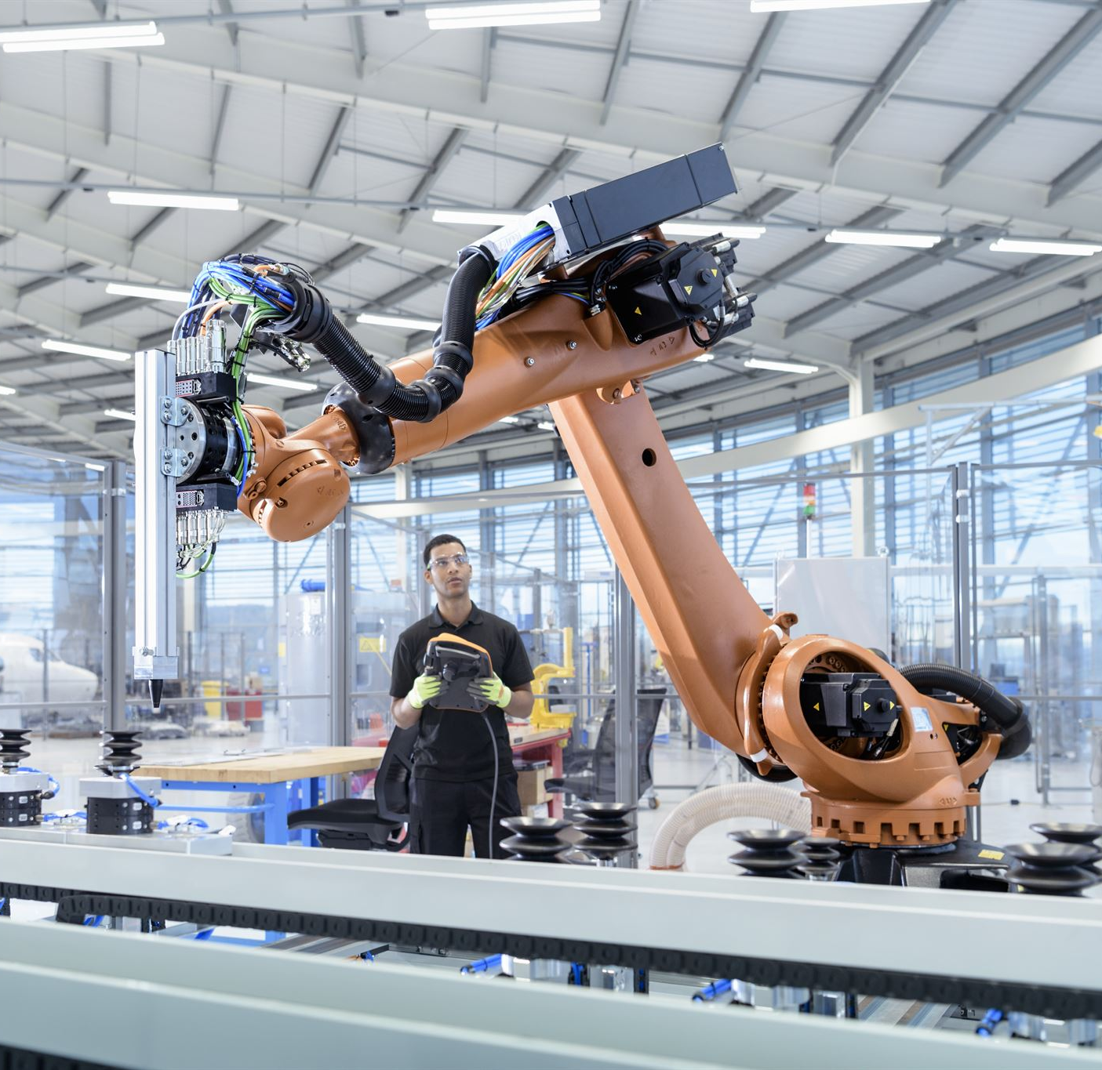
MAN Vs. MACHINE – history in one word
Origins of the word “Sabotage”
Song by the Beastie Boys, 1994.
Modern World Meaning:
“deliberately damaging, obstructing, or undermining something to weaken or stop it, especially in a workplace, political, or military context.”
From French folklore: Disgruntled factory workers threw wooden shoes, or ‘sabot’ into machines to disrupt production.
Notes:
40 Seconds (0.45) – Fear of machines taking our jobs not a new concept
- Embedded itself into our culture and more so, into our language
– as shown by word “Sabotage”
- To stop machines taking over jobs, French factory workers took matters in their own hands and threw wooden shoes into the machines to disrupt production.

Slide 3

WHAT WE THINK THE ai DATASET SHOULD TELL US?
Top 5 Questions Asked:
Which jobs are most likely to be replaced by AI?
What factors (if any) are driving the ever-growing pace of AI in the job market?
Is there a link between Exposure to AI & AI Automation Probability?
Are we training AI to replace us?
Financial Status: Are the higher-earning jobs at risk?
Notes:
40 seconds (1.25) – Brainstorming session on what we think the dataset should tell us – We will focus on no. 1 due to the quality of the dataset as shown in the next slide.

Slide 4

Ai dataset KEY insight:
“Quick & Dirty” (Initial) Analysis showed:
At-risk Jobs
Truck Drivers
Customer Support
Construction Worker
Security Guard
Retail worker
Safe-for-Now Jobs
AI Engineer
Research Scientist
Nurses
Teachers
Doctors
All other jobs
Approx. 50/50 chance of survival in 2030
Notes:
40 seconds (2.05) - What we learnt before the data deep-dive? How would we predict this?

Slide 5

INITIAL Ai dataset - observations
Synthetic Dataset – was too ‘balanced’ (‘as-is’)
No direct/usable correlation between features
Unrealistically equal distribution across the numerical features
Similar average pay – around USD 90,000
Skills scoring averages around 5.0
Average AI Exposure around 5.0
Average Automation Probability (0.49 to 0.53)
At-risk jobs inconclusive without any Feature Engineering
Feature Engineering to the rescue! (‘to-be’)
Adding new features enhanced the dataset
Notes:
40 seconds (2.45) - Data set challenges - no good correlation & all averages same - need FE

Slide 6

MACHINE LEARNING RESULTS USING NEW FEATURES
NEW FEATURES ADDED
Job Sector
Labour Group
MULTINOMIAL VS ORDINAL DISTRIBUTION
3 Risk category – order is important (low < medium < high)
MACHINE LEARNING MODELS USED – Irony?
Ordinal Scikit-Learn – Logistic Regression
Multinomial Statsmodels - LogisticAT
Random Forrest/Hyperparameter Tuning
PREDICTION RESULTS – Which ML Model won?
Random Forrest Scored – 99.33% Accuracy
Notes:
40 seconds (3.25) - 2 new features added – group at a higher level based on job sector and labour division lines (job title is still a factor as dashboard will confirm later)
- Irony not lost – as we are asking ML models to predict AI taking our jobs
- We are looking at predicting l/m/h not binary-based prediction models

Slide 7

TEAMWORK – MAKES THE DREAM WORK (Credit TO)
1. Data Analyst/Architect
- Babatunde Mushafau - Volodymyr Babunych - Teerachai (Tish) Srisasi
2. Group B - Project Managers
- Ace Pagaddu - Stefano Gioia
3. Dashboards Design & Coding (Streamlit)
- Babatunde Mushafau
4. Dashboards Design & Coding (Power BI)
- Volodymyr Babunych
Notes:
35 seconds (4.00) - Finish with team members and pass to Baba and Volodymyr

